Slide 1
VACCINE ON WHEELS
TEAM NO - D9
TEAM MEMBERS - XITIZ VERMA, YASHASWINI M, YASHASWINI SHREE

Slide 2
Introduction
The primary concern regarding COVID-19vaccination in India is the lack of adequate resources. Most of the hospitals in India face overcrowding and have congested vaccination rooms which put people at the risk of getting infected at the vaccination centre as the social distancing cannot be maintained.
Additionally, old and specially abled people find it difficult to commute to vaccination centres. But since this notion curbs the vaccination process, the problem needs a viable
Solution . One way to tackle this problem while ensuring a minimum safe
social distancing is to use mobile vaccination vans to vaccinate the
population. But once opened, a certain number of people need to be
vaccinated with a single dose. We need an efficient system that will ensure
minimum wastage of vaccines while systematically carrying out the mobile
vaccination process. Build a secure, fully functional website that solves the
above-mentioned problem.

Slide 3
Why is it worth solving?
As people become eligible to receive the COVID-19 vaccine, one obstacle they may face is finding a vaccination centre close to home. They tackle the challenges that prevent people from receiving a vaccination as follows:
1.Traveling distance.
2.Limited access to medical providers or vaccine centres.
3.Lack of mass transportation.
4.Mobility issues.
5.Work and family care schedules.
6.Lack of vaccine confidence.

Slide 4
Solution
We have designed a system to help state and local partners minimize these types of challenges so that everyone who wants to be vaccinated can be. Mobile Vaccination Centres(Vans) are one way we are making this happen.
1.Registrations will be completely free of cost.
2.As rural people doesn’t have access to digitalization, we’ll provide options for on spot registration or through a helpline number.
3.Registration will also be done through the customized website.
4.Vans will be sent according to pin code and say maximum for 100 users a day.
5.The entire process is verified by live OTP generation on user’s mobile phone.
6.Users will be able to access their details and certificate from the website.

Slide 5
Tech Stack
React JS
MySQL
Express JS
Node JS
Docker
Heroku
Github

Slide 6
Market Analysis
Total cost of all vans
Travelling cost of the van
All equipment
Vaccines

Slide 7
Implementation
The model approach is that
People who want to get vaccinated in their locality will register themselves on our customised website.
We are planning to use a OTP system for authentication of mobile number.
The registered details are stored up in a live database.
As the number of users at a certain pin code cross a particular number(say 100), we can send out a van ,equipped with certain number of Vaccine doses(According to their availability), along with a medical staff, to the respective pin code and the vaccination can be effectively carried out reducing the congestion at the Hospitals at a large.
If the number of registered users at a pin code exceed far beyond the threshold vaccine number (here 100) for a van(say 500),we can sort the registered candidates according to their age sort by descending , so that the older and specially abled people would be able to get the vaccines first!
When the doctor will vaccinate a candidate ,we are planning to do a live OTP verification System, so that the authenticated candidates only receive the dosage!

Slide 8
2. A OTP system for authentication of mobile number
1.People who want to get vaccinated in their locality will register themselves on our customised website.
3. Details are stored up in a live database
The model approach
6. The doctor will vaccinate a candidate the authenticated candidates only receive the dosage!
4. The vaccination can be effectively carried
5.Older and specially abled people would be able to get the vaccines first!

Slide 9
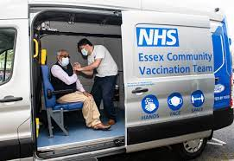
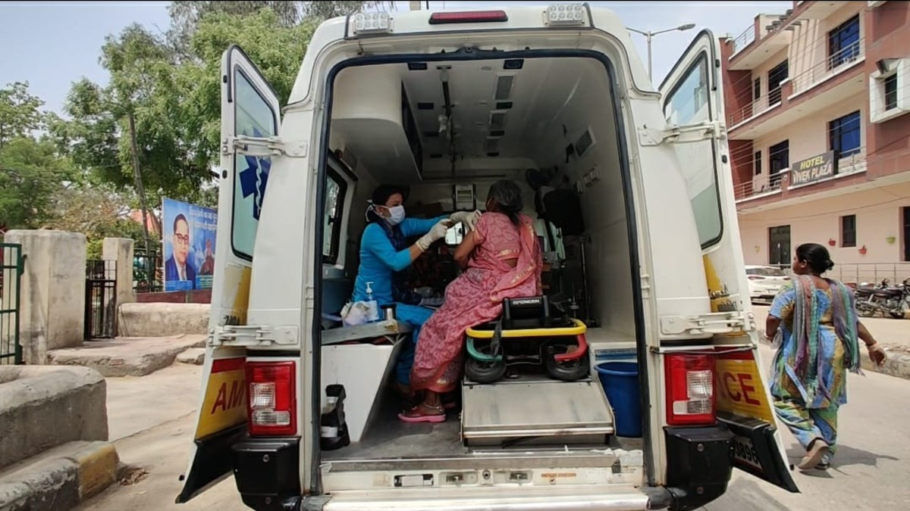
Similar images
Source-https://media.ford.com/content/fordmedia/feu/gb/en/news/2021/05/06/nhs-and-ford-pilot-bespoke-transit-van-to-deliver-covid-19-vacci.html
Source- https://theprint.in/health/temples-mosques-gurdwaras-help-ambala-get-high-vaccination-rate-best-haryana-district-tag/640001/

Slide 10
Thank You

